Slide 1

Trello By Heinrich Naatwilwe Aluvilu
Project Collaboration Management Simplified

Slide 2
CONTENTS
INTRODUCTION AND BACKGROUND
AUDIENCE
TRELLO
Features
Uses
Architecture
Pros and Cons
TRELLO APPS AND PLATFORMS
TRELLO ALTERNATIVES
REFERENCES
SUMMARY
DEMO (WEB + MOBILE)
Account Registration
Installation and Setup
Use Case: Software Project Management (OWA)

Slide 3
INTRODUCTION AND BACKGROUND
Trello is a collaboration tool that organizes your projects into boards. In one glance, Trello tells you what's being worked on, who's working on what, and where something is in a process.
Trello is a web-based project management application originally made by Fog Creek Software in 2011, that spun out to be its own company in 2014
Trello operates a freemium business model
Trello has a basic free service, however a Business Class paid-for service Software products
Trello was released in 2011 at a TechChrun event by Joel Spolsky
After that, the rest was history. Users as well as funding continue to go up

Slide 4
AUDIENCE
Anyone really. Yes, you are welcome.

Slide 5
TRELLO
Features
Trello uses the Kanban paradigm for managing projects, originally popularized by Toyota
Projects are represented by boards, which contain lists (corresponding to task lists). Lists contain cards (corresponding to tasks)
Cards are supposed to progress from one list to the next (via drag-and-drop), for instance mirroring the flow of a feature from idea to implementation.
Users can be assigned to cards. Users and boards can be grouped into organizations
It supports iPhone, Android and Windows 8 mobile platforms, however, its website has been designed to be accessible in most mobile web browser
Uses
Trello has a variety of work and personal uses including real estate management, software project management, school bulletin boards, lesson planning, and law office case management

Slide 6
…. continued
Architecture
According to Fog Creek, the maker of Trello, the website is built on top of MongoDB, Node.js and Backbone.js

Slide 7
Pros and cons
Pros
It’s free! You can use right away after signed up at Trello.
You can use Trello on about any size of screen. Its interface is much more different from other services. Trelllo looks like an App, not a site.
Real time updates is amazingly fast! Almost right away!
A board for a project and you can see all the items on one page.
Creating issues and assigned someone to those issues are simple and easy.
Adding new member is easy. You can not only add existing user to your board but also invite new users by type in emails.

Slide 8
… Continued
Cons
No gantt (project bar chart)
Can’t write documents or wiki about boards, only simple description.
No calendar.

Slide 9
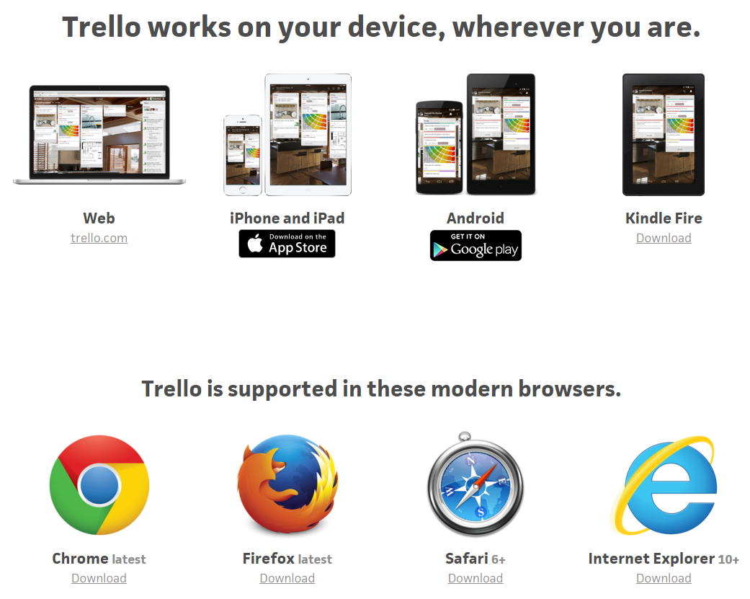
TRELLO APPS AND PLATFORMS

Slide 10
TRELLO ALTERNATIVES
Aha! | Eylean Board | Pivotal Tracker (product) | Yodiz
Brightpod | Fusioo | ProductPlan | ZenHub.io
Planio | JIRA | ProofHub
Canvazify | Jixee | SprintGround
Casual.pm | Kanban Tool | Twoodo
daPulse | Planiro | Wiplo

Slide 11
REFERENCES
https://en.wikipedia.org/wiki/Trello
http://www.projectmanagers.net/i/the-pros-and-cons-of-trello/
https://www.quora.com/What-are-the-best-alternatives-to-Trello
https://trello.com/platforms
http://help.trello.com/article/734-how-to-use-trello-like-a-pro

Slide 12
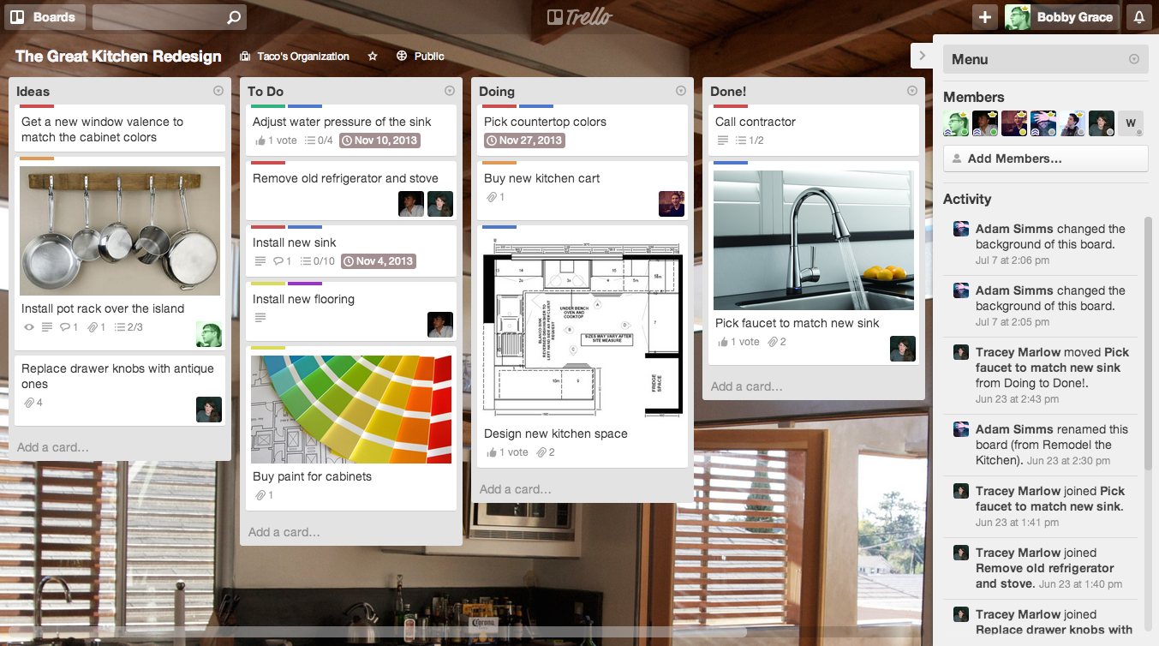
Summary

Slide 13
…. continued
Drag and drop cards between lists to show progress. Add as many people as you need and drag them to cards. Add and reorder lists as you need. Trello adapts to your project, team, and workflow.
You’ll see everything about your project just by glancing at the board, and it all updates in real-time. There’s nothing to set up and everyone gets it instantly.
Trello is simple on the surface, but cards have everything you need to get stuff done. Post comments for instant feedback. Upload files from your computer, Google Drive, Dropbox, Box, and OneDrive. Add checklists, labels, due dates, and more. Notifications make sure you always know when important stuff happens.
You can invite as many people to your board as you need, all for free. Drag and drop people to cards to divvy up tasks. Everyone sees the same board and the whole picture all at once.

Slide 14
DEMO (WEB + MOBILE)
Account Registration
Installation and Setup
Use Case: Software Project Management (NUST O’WEEK)

